Slide 1
COM Hijacking Techniques

Slide 2

Who am I?
David Tulis
Offensive security practitioner and researcher
Currently living in Philadelphia
Senior Security Consultant with NCC Group
Red team operations lead
Windows and Active Directory pentesting
Social engineering, physical security
Twitter: @kafkaesqu3

Slide 3
Talk agenda
COM fundamental concepts
Real-world use cases
The insecure COM object loading process
Identifying hijack events on a system
Hijack demos
Techniques for stabilizing COM hijack
Practical usage in offensive operations
Takeaways for red/blue teams

Slide 4
Why am I doing a talk just about COM hijacking
COM is deeply ingrained in all versions of Windows OS
The interface can be used in unexpected ways
An adversary likes to use things in unexpected ways
COM hijack abuse is a method to have another process run untrusted code
Host persistence
Defence evasion
Lateral movement
T1122 on the MITRE ATT&CK framework
MITRE has recorded 6 different threat groups abusing COM hijacking
Minimal public information about COM hijacking abuse

Slide 5
WTF is COM?
COM = “Component Object Model”
Released in 1992 in Windows 3.1
COM lies at the core of many Windows OS technologies and frameworks
OLE, ActiveX, COM+, DCOM, Windows shell, DirectX, UMDF, WinRT
COM is a standard to facilitate program interoperability, code reuse, and interprocess communications

Slide 6
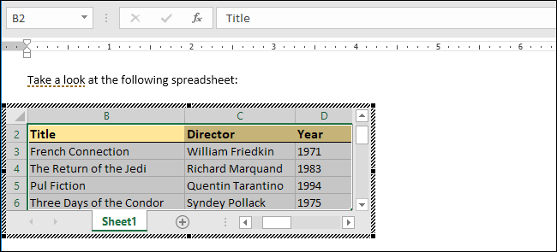
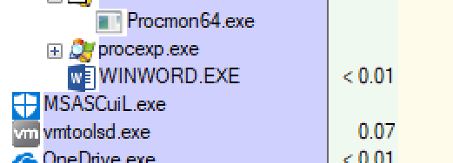
COM example #1
COM was originally created by Microsoft engineers as a framework document linking and object sharing
Through COM, you can get full access to the Excel API, in Word, without creating an Excel process

Slide 7
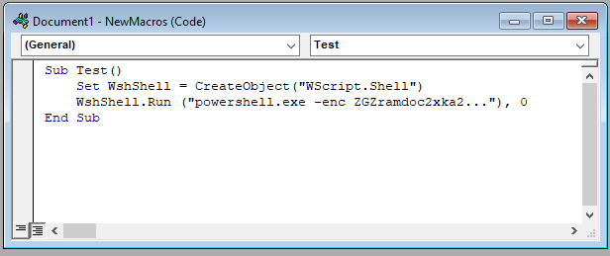
COM example #2
Does this code look familiar?
Creating and executing an arbitrary command in VBA, using Wscript.Shell COM object

Slide 8
Why COM?
Applications need a way to share objects, code.
Statically linking .lib = developers must compile against your library, wasted space from duplicate libraries (BAD)
Dynamic linking .dll = no versioning control, “DLL hell” (BAD)
COM = GOOD
COM core principle: “separate the implementation from the interface”
COM libraries can can be called from any process, in any language
COM libraries can be modified without breaking the binary-level interface

Slide 9
COM server components
COM library == COM Server
A COM server contains the library’s implementation (code and classes), and an interface for accessing the implementation
Other applications that want to interact with the server are the COM clients
COM servers can be hosted in process (a DLL) or out of process (an EXE)
COM classes are given names
ProgID: Friendly name (LibraryName.ClassName.Version)
CLSID: Unique name {5d58708c-5603-4ee0-81de-e88ec9ece235}
COM interfaces are also given names an interface identifier (IID), also a GUID
All COM interfaces expose 3 methods:
QueryInterface - retrieve references to the interfaces an object implements
AddRef/Release - increment/decrement object reference counter

Slide 10
COM client programming
COM clients can be written in any language
.NET: COM Interops
VBA: CreateObject
Powershell: New-Object -ComObject
Python: pywin32
Ruby: win32ole
Node: win32com
Golang: win32com.client
CoCreateInstance() is the Windows API call to activate an object
CoGetClassObject() to retrieve pointer to interface of specified CLSID
CreateInstance() to create an uninitialized object
QueryInterface() to determine if a server supports a specific interface
COM DLLs export DllGetClassObject(), which is what QueryInterface() calls
If you don’t know the CLSID of an object, use CLSIDFromProgID()

Slide 11
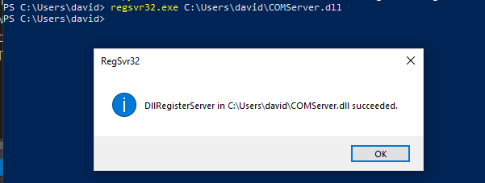
COM object registration
COM objects can self-register using regsvr32.exe
This is done through exported functions:
DllRegisterServer
DllUnregisterServer

Slide 12
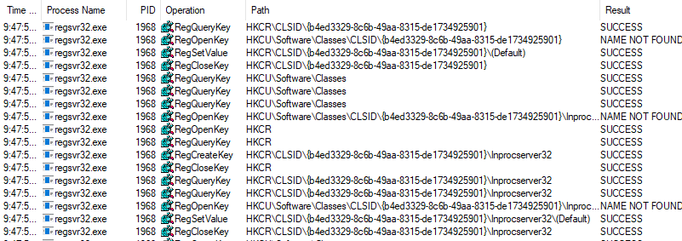
COM object registration

Slide 13
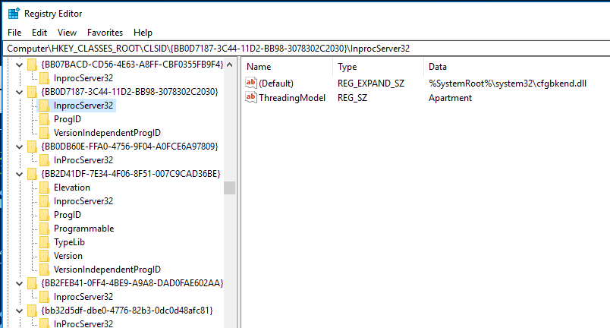
COM object registration

Slide 14
COM object registration
Important subkeys:
InprocServer/InprocServer32 - in process COM objects
LocalServer/LocalServer32 - external COM objects, in another process
InprocServer/LocalServer keys are for backwards compatibility for 16 bit exes and not common
32-bit, 64-bit processes/process servers use InprocServer32/LocalServer32
COM object registration registry hives:
Per-user object registration: HKEY_CURRENT_USER\Software\Classes\CLSID
System-wide registration: HKEY_LOCAL_MACHINE\Software\Classes\CLSID
HKEY_CLASSES_ROOT (HKCR) is a virtual registry hive, showing merged view of HKCU and HKLM

Slide 15
COM object population survey
Test box: Windows 10 Pro
Browsers: Chrome
Productivity: Microsoft Office 2016
Total: 6557 CLSIDs
6338 InprocServer32 keys
219 LocalServer32 keys
0 LocalServer/InprocServer keys ):
18 keys in HKCU hive
6539 keys in HKLM hive
1679 unique COM server implementations on disk
1608 in-process COM servers (.DLLs)
149 out-of-process COM servers (.EXEs)
Misc file types (.ax, .cpl, .ocx)

Slide 16
Try this at home!
$HKCR_keys = Get-CLSIDRegistryKeys -RegHive HKCR
$HKCR_keys | where-object {$_ -like "*inprocserver"} | Measure-Object
$HKCR_keys | where-object {$_ -like "*inprocserver32"} | Measure-Object
$HKCR_keys | where-object {$_ -like "*localserver"} | Measure-Object
$HKCR_keys | where-object {$_ -like "*localserver32"} | Measure-Object
$HKLM_keys = Get-CLSIDRegistryKeys -RegHive HKLM
$HKLM_keys | Measure-Object
$HKCU_keys = Get-CLSIDRegistryKeys -RegHive HKCU
$HKCU_keys | Measure-Object
Powershell cmdlets from https://github.com/nccgroup/Accomplice/COMHijackToolkit.ps1

Slide 17
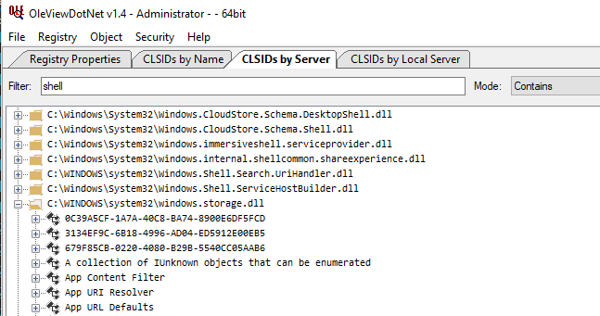
Exploring your system’s COM components in detail
Microsoft’s Oleview, part of Windows SDK
James Forshaw’s OLEViewDotNet- https://github.com/tyranid/oleviewdotnet/

Slide 18
The vulnerability in the object resolution process
Keys are loaded from
Per-user object registration: HKCU\Software\Classes\CLSID < -- PRECEDENCE
System-wide object registration: HKLM\Software\Classes\CLSID
Per-user COM registration has precedence over system-wide COM object registration
This means keys are read from HKCU before they are read from HKLM
Exception to this rule: elevated process read directly from HKLM to prevent trivial privilege escalation
As we saw above, the vast majority of objects are registered at system-wide
No special privileges are required to add keys to HKCU!
Even if client read keys from HKCR (HKLM+HKCU), a CLSID duplicated in HKLM and HKCU will only show the value from HKCU

Slide 19
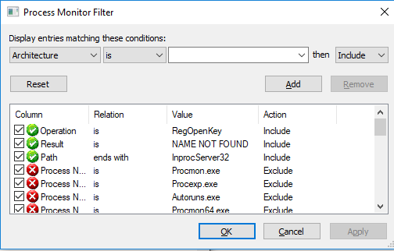
Finding hijackable keys
Test box is Windows 10 Pro with Chrome and Office 2016 installed
Because the largest number of keys are in-process, we will focus on these
Testing strategy = Identify COM objects activated:
At regular intervals
At application launch
By common actions (open file, click icon, etc)
Testing time: About 5 minutes?
Procmon filters:
Operation is RegKeyOpen
Result is NAME NOT FOUND
Path ends with InprocServer32
Exclude if path starts with HKLM

Slide 20
Test results

Slide 21
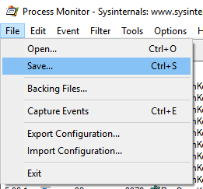
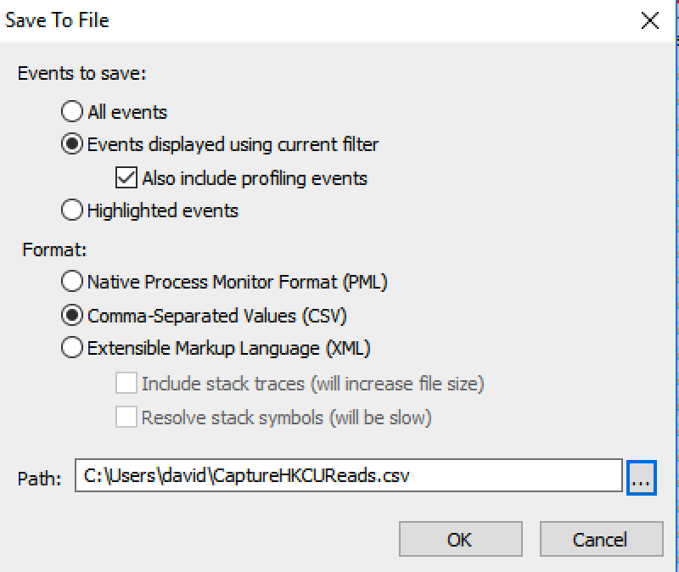
Export events from Procmon as CSV

Slide 22
Results
Extract-HijackableKeysFromProcmonCSV -CSVfile CaptureHKCUReads.CSV
Results: 628 unique InprocServer32 CLSID keys we can hijack:
explorer.exe:122
winword.exe:99
powerpnt.exe:95
excel.exe:90
chrome.exe:87
outlook.exe:85
other: 50
cmdlet from https://github.com/nccgroup/Accomplice/COMHijackToolkit.ps1

Slide 23
Creating a target library
InprocServer32 target must be a DLL
DLL does not need to be a valid COM library
No need to implement COM registration or interface querying functions
DLL files have an initialization function called DllMain, the perfect place for our code
Whenever process loads or unloads the DLL, DllMain is called
Whenever a process creates or exits a thread, DllMain is called
In the case of COM activation, calls to CoCreateInstance() or CreateInstance() to a CLSID with an in-process COM server will trigger DllMain
Loader lock is held system-wide before entering DllMain
Loader lock exists to address the fragility of the Windows loader
Can’t load any other DLLs
Can only call functions already mapped into memory (kernel32.dll)
Can’t lock anything, or wait for any locks to be released
Can’t wait for other processes/threads to complete

Slide 24
DllMain implementation
BOOL APIENTRY DllMain(HMODULE hModule, DWORD ul_reason_for_call, LPVOID lpReserved)
{
switch (ul_reason_for_call) {
case DLL_PROCESS_ATTACH: {
DoEvilStuff(NULL);
break;
}
case DLL_THREAD_ATTACH:
case DLL_THREAD_DETACH:
case DLL_PROCESS_DETACH:
break;
}
return TRUE;
}

Slide 25
Option #1: Create process
//spawning a new process
DWORD WINAPI DoEvilStuff(LPVOID lpParam) {
STARTUPINFO info = { 0 };
PROCESS_INFORMATION processInfo;
std::wstring cmd = L"C:\\Windows\\System32\\calc.exe";
BOOL hR = CreateProcess(NULL, (LPWSTR)cmd.c_str(), NULL, NULL,
TRUE, 0, NULL, NULL, &info, &processInfo);
if (hR == 0) {
return 1;
}
return 0;
}

Slide 26
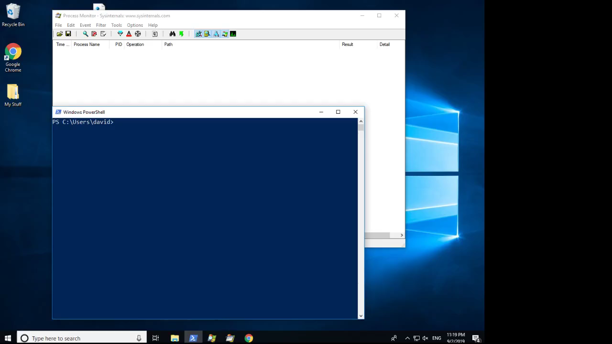

Slide 27
Option #2: Thread injection
Spawning processes is expensive
We are safe to call functions in kernel32.dll while loader lock is held
OpenProcess()
VirtualAllocEx()
WriteProcessMemory()
CreateRemoteThread()
With this recipe, we can inject shellcode into another process
https://github.com/theevilbit/injection/blob/master/SimpleThreadInjection/SimpleThreadInjection/SimpleThreadInjection.cpp

Slide 28
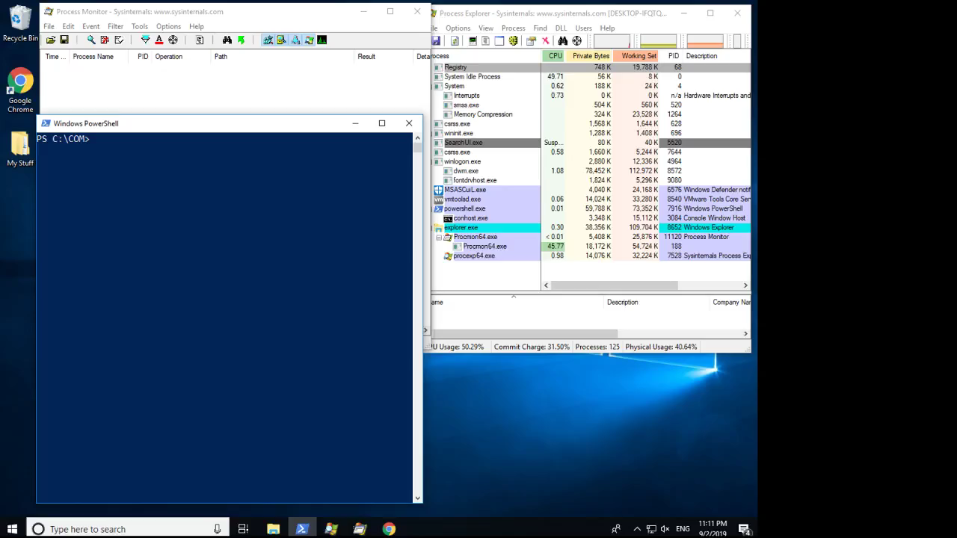

Slide 29
Option #2: Thread injection
Pros: This injection technique prevents spawning new processes
Cons: Shellcode injection techniques are well known to defender
There are lots of injection techniques, some more well known than others
Injection technique implementation examples https://github.com/theevilbit/injection
Anything that only uses kernel32.dll will work!

Slide 30
Option #3: CreateThread()
Can we keep ourselves running in the COM client process?
We COULD call CreateThread() inside DLLmain, but the thread won’t run until DllMain exits and loader lock is released
An alternative to running malicious code in DllMain is to run when the COM object is activated
DllGetClassObject() is an exported function called when a COM object is activated
There is NO loader lock inside DllGetClassObject()
DllCanUnloadNow() – when a client calls CoFreeUnusedLibraries() to free up space, this function will be called
Return S_FALSE to tell clients the library is still being used and not to unload it

Slide 31
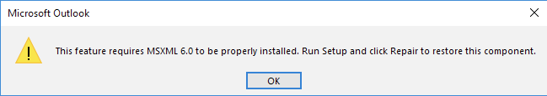
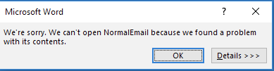
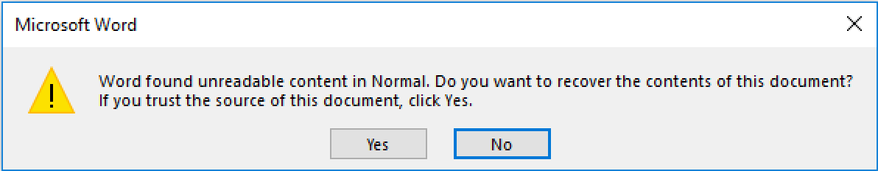
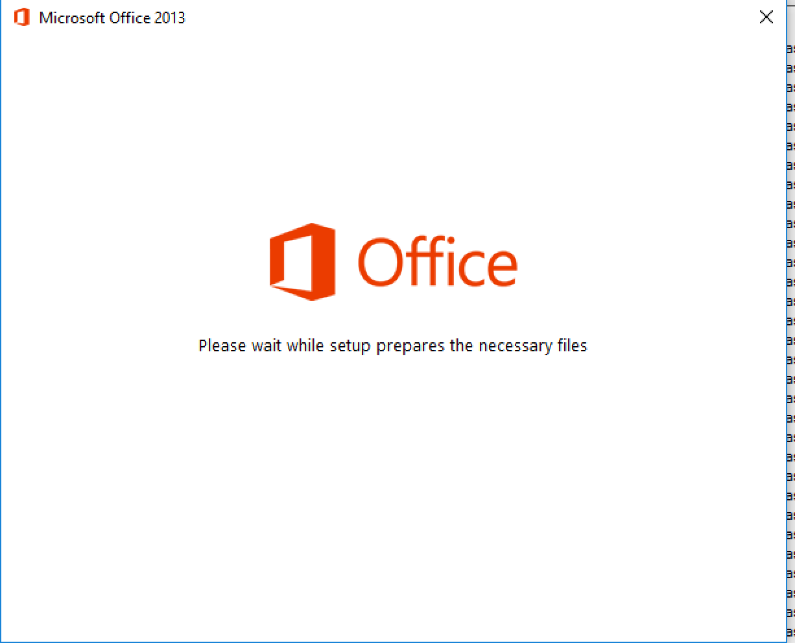
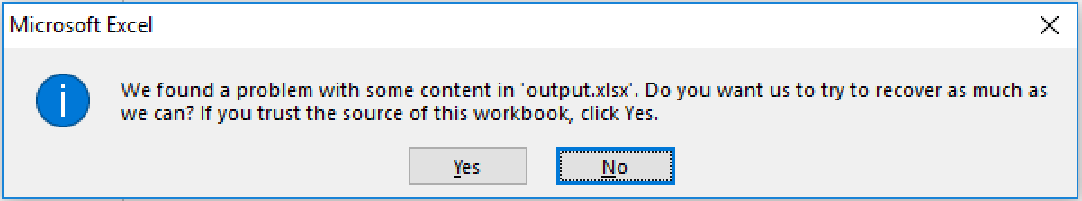
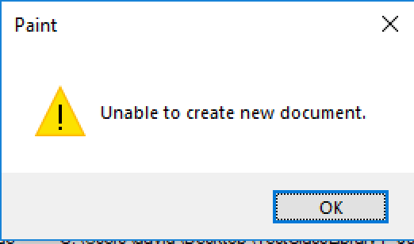
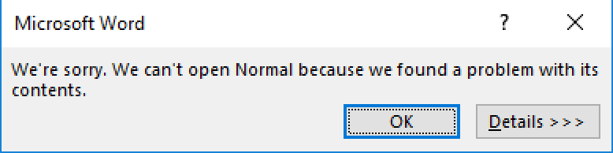
COM client post-hijack behavior
We have no guarantee that our thread will be forcibly killed and our DLL unloaded
DLL name and path not what is expected
DLL has no exports
We aren’t implementing the COM interfaces the client is expected
The COM client may crash or misbehave

Slide 32
Measuring thread lifetimes post-hijack
Some COM clients don’t care that no COM object was loaded, and the thread stays running
Some COM clients kill the thread but keep DLL loaded. Others crash completely
Some example CLSIDs you can hijack without being outright killed or unloaded (DllMain or DllGetClassObject):
excel.exe - {33C53A50-F456-4884-B049-85FD643ECFED}
explorer.exe - {A4B544A1-438D-4B41-9325-869523E2D6C7}
outlook.exe - {529A9E6B-6587-4F23-AB9E-9C7D683E3C50}
chrome.exe - {1F486A52-3CB1-48FD-8F50-B8DC300D9F9D}
Tedious testing process, no guarantees on future stability
Create threads both in DllMain and DllGetClassObject
DllGetClassObject may be called more than once
Thread updates a file with its progress
Instead of creating and writing to a file, you could have this function do “whatever you want” ;)
Be mindful of loader lock restrictions on the thread created in DllMain
Thread is started when loader lock is released

Slide 33
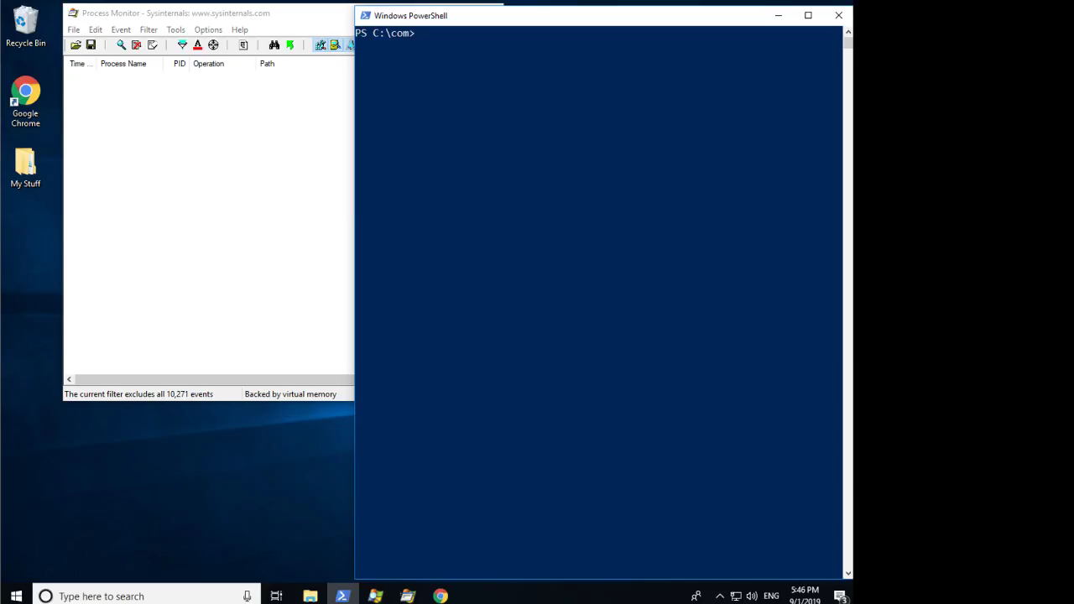
demo3-take2.flv

Slide 34
Alternative to DLLs: Scriptlets
Maybe you aren’t comfortable dropping DLLs into target environment
COM servers can be Windows Scripting Components (.sct files)
Technique originally documented by @subtee and @enigma0x3
https://www.slideshare.net/enigma0x3/windows-operating-system-archaeology
InprocServer32 = C:\Windows\system32\scrobj.dll
ScripletURL = Location of .sct file (local on disk or a URL)
Blue team take note: This is NOT a common occurrence

Slide 35
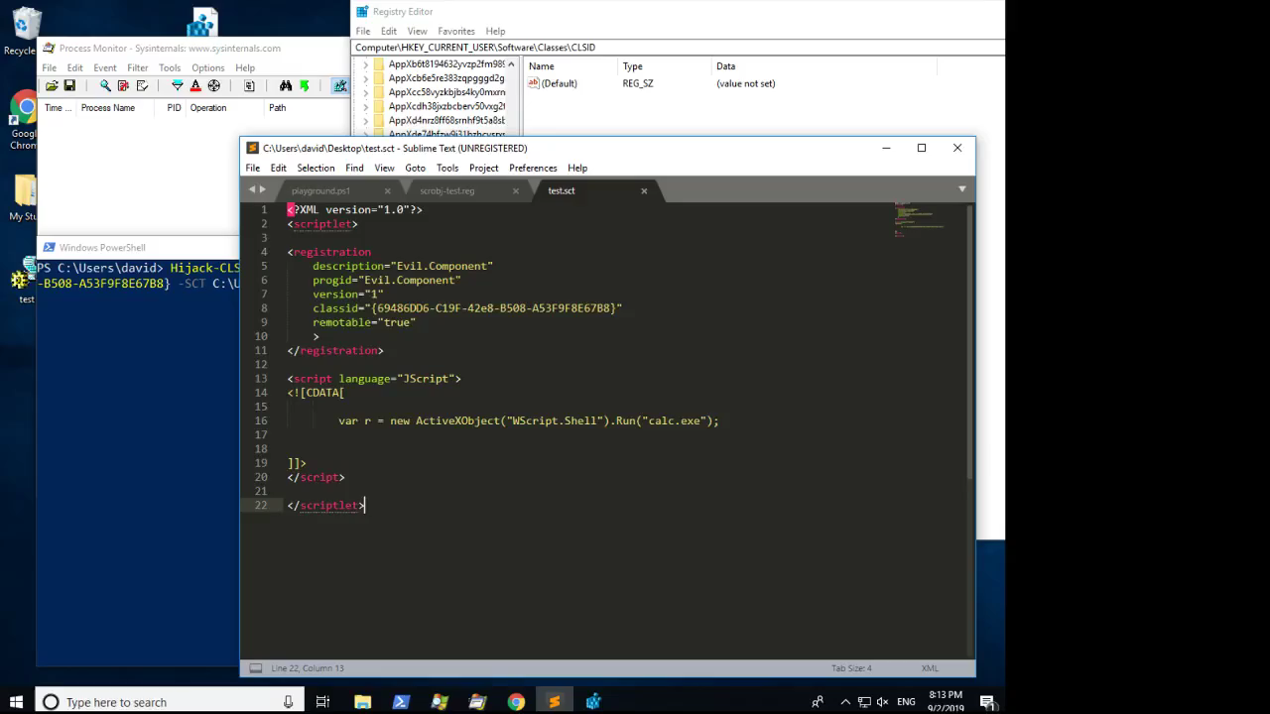

Slide 36
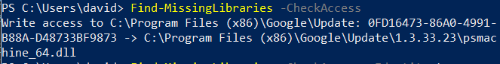
Hijacking abandoned keys
In some cases, there will be CLSIDs Inprocserver32 keys that point to a DLL that doesn’t exist on disk
Most COM servers live in C:\Windows\System32, which is writable by Administrators only
Default Windows does not have any missing COM servers,
Systems with 3rd party software (especially when software components have been uninstalled) might have more
Example of an abandoned key left by an old version of Google Chrome (note: folder is only writable to administrators)
Technique originally documented by @bohops: https://bohops.com/2018/06/28/abusing-com-registry-structure-clsid-localserver32-inprocserver32/

Slide 37
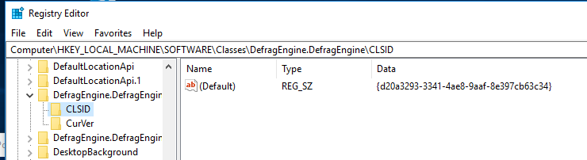
ProgID resolution hijacking
ProgIDs are the not-guaranteed-to-be-unique names of COM classes
ProgIDs are resolved to their CLSIDs in the registry keys:
HKCU\Software\Classes
HKLM\Software\Classes
A ProgID can be hijacked by adding a false ProgID to CLSID mapping in HKCU
When a clients activates a COM object using the ProgID, the OS will resolve the ProgID by reading HKCU\Software\Classes\ProgID

Slide 38
TreatAs hijacking
“TreatAs” registry key signals that a CLSID can be emulated by another CLSID
Originally documented by @subtee and @enigma0x3 in their Windows Operating System Archaeology presentation
TreatAs key points to another CLSID which is capable of emulating the current CLSID
All activation requests are forwarded to the CLSID in TreatAs
If emulated class doesn’t implement the right interfaces, there will be program instability
Create the malicious CLSID in HKCU, with a target COM server of choice
Hijack legitimate CLSID by adding TreatAs subkey, pointing to attacker’s CLSID

Slide 39
Persisting via COM hijack
COM hijacking primary use case: persistence
Drop SCT/DLL/EXE to disk
Add a registry key pointing attackers COM server, under the CLSID you want to hijack (optional if abusing an abandoned key)
InprocServer32 -> DLL
LocalServer32 -> EXE
InprocServer32 -> Scrobl, ScriptletURL -> SCT file
TreatAs/ProgID
Wait for CLSID to be activated
Not a common technique
No reboots required
COM hijacks are invisible to Sysinternals Autoruns

Slide 40
COM proxying
Signature for DllGetClassObject:
HRESULT DllGetClassObject(REFCLSID rclsid, REFIID iid, LPVOID*ppv)
When a COM client loads the library’s DllGetClassObject function:
Start a thread DoEvilStuff()
Given rclsid argument, read COM DLL location from registry
Load the legitimate DLL
Find address of DllGetClassObject in legitimate library
Pass arguments to DllGetClassObject in legitimate DLL
In DllCanUnloadNow, wait for EvilStuff() to finish before unloading
We can LoadLibrary and wait for threads, because DllGetClassObject isn’t called during loader lock
Thanks Leo! https://github.com/leoloobeek/COMProxy/

Slide 41
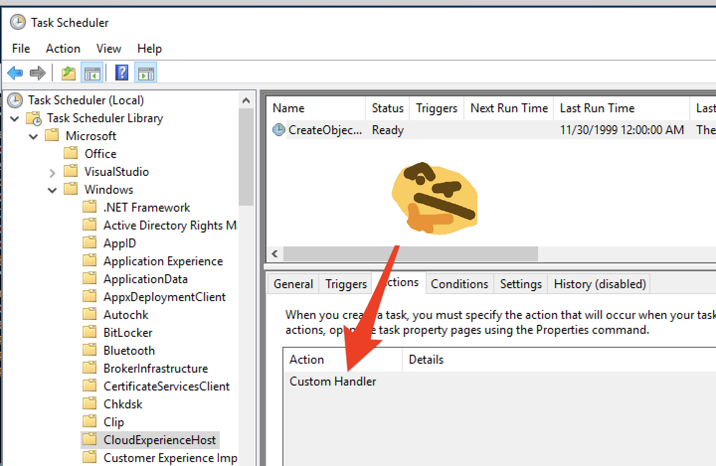
Persisting via COM hijack of scheduled task handler
Originally documented by Matt Nelson in 2016: https://enigma0x3.net/2016/05/25/userland-persistence-with-scheduled-tasks-and-com-handler-hijacking/

Slide 42
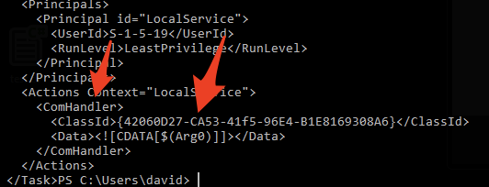
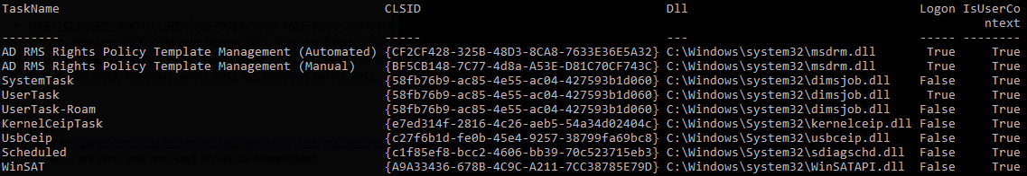
Persisting via COM hijack of scheduled task
schtasks /query /xml /tn '\Microsoft\Windows\Shell\CreateObjectTask
https://github.com/enigma0x3/Misc-PowerShell-Stuff/blob/master/Get-ScheduledTaskComHandler.ps1

Slide 43
Process injections via COM hijack
Process injection is a defence evasion technique, where malicious code is run by other processes on the system
Lots of documented techniques for performing this
COM hijacking is a unique method of injecting code into another process's address space through registry manipulations only
No calling of "suspicious" Windows APIs
By mapping which CLSIDs are associated with which processes, hijacking particular keys will cause injection into particular processes
Drawback: Potential "time delay" until event occurs which triggers the hijack

Slide 44
COM abuse to blend in and misdirect
Advanced attackers want to blend in to the environment they are operating in
These techniques do not necessarily rely on a hijack, but could be combined with other techniques to misdirect defensive actions
Application whitelisting bypass: Invoke any CLSID:
rundll32.exe -Sta {CLSID} OR ProgID
Other programs which take CLSIDs as arguments: xwizard.exe, mmc.exe, verclsid.exe, cscript.exe, wscript.exe, openwith.exe
Lateral movement: DCOM
Remote registry writes to hijack a CLSID (optional if abusing abandoned CLSIDs)
Drop DLL/EXE to remote host file system
Use DCOM to activate the object on the remote host, or wait for it to be invoked locally by the COM client
Original documented by @bohops: https://bohops.com/2018/04/28/abusing-dcom-for-yet-another-lateral-movement-technique/

Slide 45
Takeaways for offense
COM hijacking is not a widely used persistence technique, and your target environments may not be prepared to detect this activity
This persistence can be installed from userland
Abuse of the COM interface provides offensive operators with layers of misdirection
New styles of initial access vectors
COM hijacks can be used for process injection
This violates application code integrity by loading untrusted code
Will not bypass Microsoft's implementation Code Integrity Guard
Other "hardened" applications might not prevent COM hijacks from loading untrusted code

Slide 46
Takeaways for defense
COM hijacking is not a widely used persistence technique, and your SOC may not be prepared to detect this activity
Software does not usually register COM objects per-user
Any processes writing keys to HKCU\Software\Classes\CLSID doesn’t happen very often, and should be treated with suspicion
SwiftOnSecurity’s Sysmon configuration tracks HKCU CLSID addition
Watch for the addition of ScriptletURL keys where the InprocServer32 key registered to scrobj.dll
Watch for the addition of TreatAs keys
If your users are widely given administrator privileges, an attacker could avoid HKCU and hijack objects via HKLM modifications
HKLM is owned by TrustedInstaller
Check systems for key abandonment. Exploiting CLSIDs without a DLL on disk does not require any registry modifications

Slide 47
Takeaways for developers
If you are developing security sensitive or critical applications that rely on COM libraries, that run in userland, and you don’t want somebody using COM hijacks to load a malicious library:
Avoid relying on Windows to resolve the location of the COM server
Identify the location of the library (registry, file system checks)
LoadLibrary() to load DLL
Directly call DllGetClassObject on the COM DLL to retrieve interface pointers
Other recommendations:
Don’t add CLSIDs for non-existent COM servers
Don’t leave CLSIDs for removed components

Slide 48
Future work
Hijacking out of process COM servers
Identifying other abusable registry keys
Using COM hijacks for application hooking
Intercepting/modifying application behaviour
Access to sensitive data
Using instrumentation frameworks such as Frida to have more visibility into COM client behavior
Objects that give "bonus effects" when hijacked. Examples:
Matt Nelson: AMSI bypass via COM hijack https://enigma0x3.net/2017/07/19/bypassing-amsi-via-com-server-hijacking/
James Forshaw: Execution inside protected process for ring0 privileges: https://googleprojectzero.blogspot.com/2017/08/bypassing-virtualbox-process-hardening.html
Other userland processes relying on COM? AV/EDR, anybody?

Slide 49
Introducing your new acCOMplice
https://github.com/nccgroup/Accomplice
COMHijackToolkit.ps1
Surveying COM objects on a system
Hijacking objects
Hijack cleanup
POC DLLs for demonstrated in this talk
POCs for running payloads from DllMain
DLL to measure the success of hijacks
Process migrations

Slide 50
Credits!
Thank you to friends who answered my questions:
Leo Loobeek (@leoloobeek)
Michael Weber (@BouncyHat)
Thanks to NCC Group's wonderful research directors for their support:
Jeff Dileo (@ChaosDatumz)
Jennifer Fernick (@enjenneer)
Thank you to the researchers who’ve published research on COM abuse:
James Forshaw (@tiraniddo)
Casey Smith (@subtee)
bohops (@bohops)
Matt Nelson (@enigma0x3)
Philip Tsukerman (@philiptsukerman)
Ruben Boonen (@FuzzySec)

Slide 51
Questions?
Github (soon!): https://github.com/nccgroup/Accomplice
Twitter: @kafkaesqu3

